Slide 1
Preliminary write-up
By: Dario Rendon
Xiang Fan

Slide 2
Describing scene for end of Assignment 4
A 2 armed robot trying to catch a flying robot
Model 1 – robot with 2 arms
Model 2 - ???
Camera movements:
3rd/1st person view behind each model
Orbit around center point of the 2 arms

Slide 3
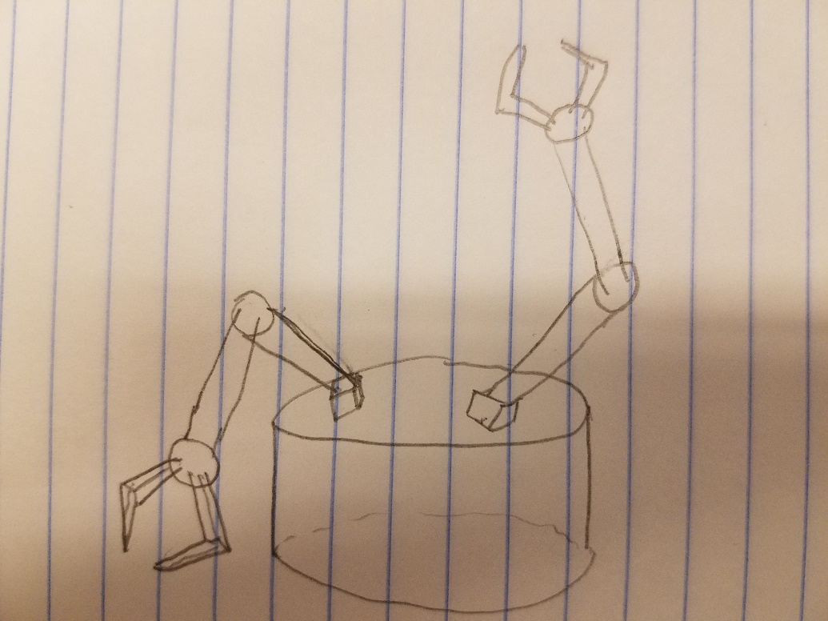
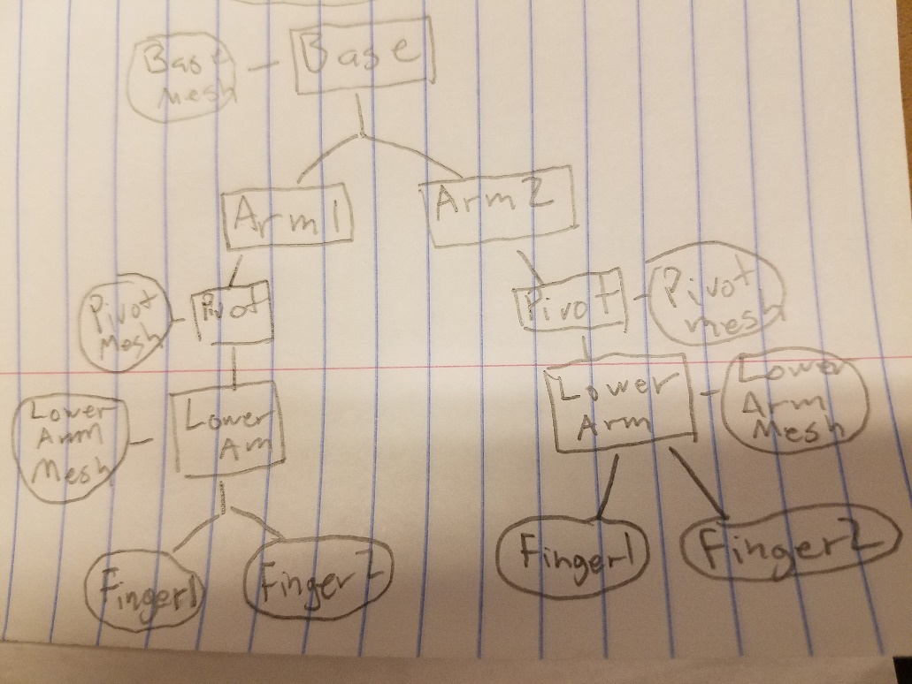
Description of Model 1: A robot with 2 arms
All motion should be only rotations pivoting off of the previous segment of the model with the exception of the base which can slide around
Each arm segment should only have 1 axis of motion much like a robot arm

Slide 4
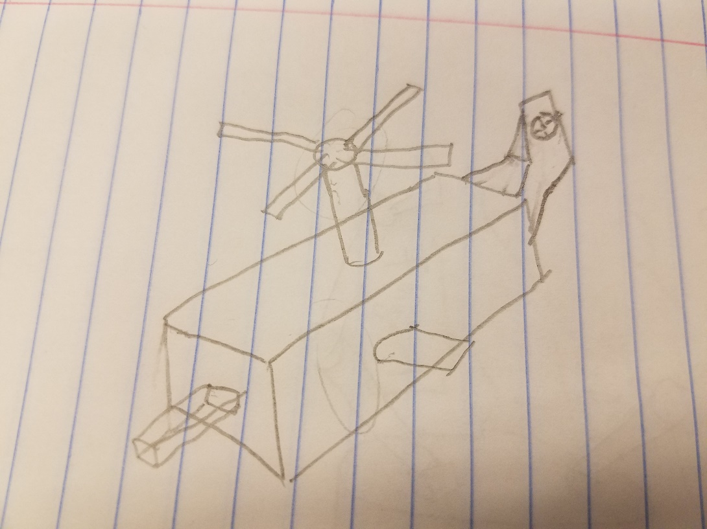
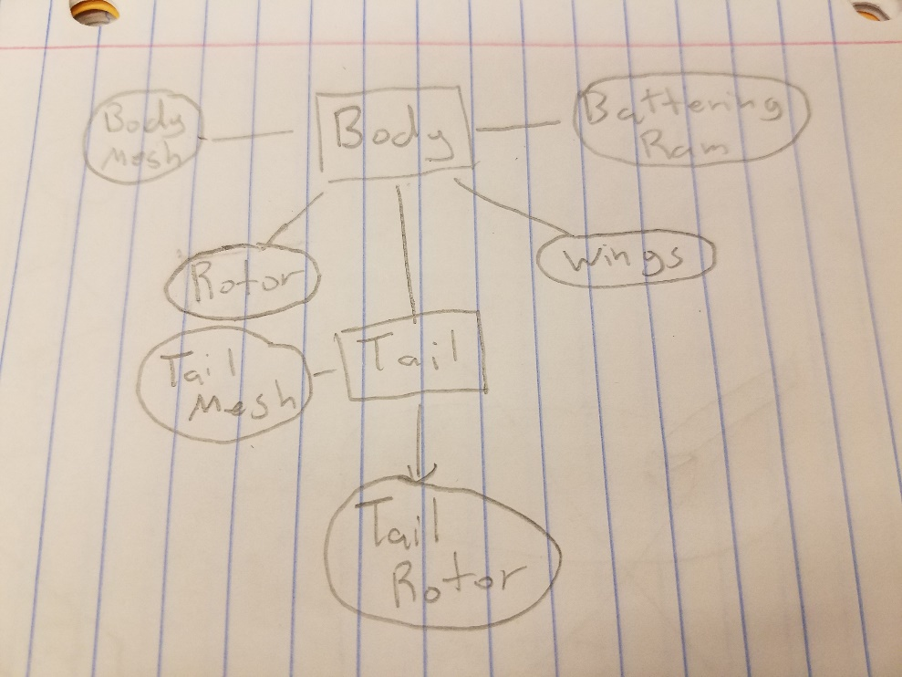
Description of Model 2: Attack Helicopter
Rotor at top spins
Rotor in back also spins
Battering ram in front goes in and out
Side rudders rotate slightly

